Slide 1

Skin Cancer Detection with 3D Total Body Photos
Madelyn Esther Cruz
Maksim Kosmakov
Notes:
Hello everyone. The question we decided to chase down is a longstanding problem: how can we improve early detection of skin cancer. Our project, Skin Cancer Detection with 3D Total Body Photos, was developed by Madelyn Esther Cruz and Maksim Kosmakov.

Slide 2
Project Overview and Objectives
Objective: Develop AI algorithms to differentiate malignant from benign skin lesions.
Inspiration: ISIC2024 Kaggle Competition.
Context
Problem: Skin cancer can be fatal if undiagnosed; many underserved populations lack access to specialized dermatologic care.
Solution: AI algorithms to analyze lower-quality images, similar to smartphone photos used in telehealth
Task: Create a binary classifier for skin cancer using 3D total body photos (TBP) with single-lesion crops.
Benefit: Enhances triage and early detection of skin cancer, especially in settings with limited specialized care.
Notes:
Script:
Skin cancer can be fatal if not diagnosed early, yet many underserved populations lack access to specialized dermatologic care.
Fortunately, a large dataset is now available online, consisting of 3D total body photos with single-lesion crops. This presents an opportunity to leverage dermoscopy-based AI algorithms to assist clinicians in diagnosing melanoma, basal cell carcinoma, and squamous cell carcinoma by improving early diagnosis and disease prognosis.
For our project, we aim to develop AI algorithms to differentiate histologically confirmed malignant skin lesions from benign ones using the International Skin Imaging Collaboration (ISIC) SLICE-3D 2024 Challenge Dataset. Each image will be assigned a probability that it represents a malignant case.
Our project is inspired by the corresponding Kaggle Competition, and we hope it will help improve early detection and triage of skin cancer.

Slide 3
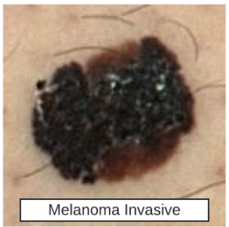
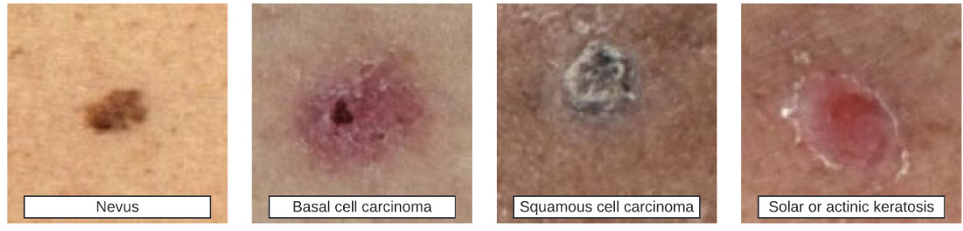
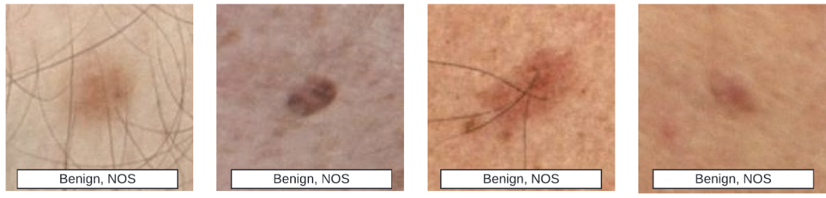
Melanoma vs Benign Lesion Classification
Highly imbalanced large dataset, 401k Images in total, 1042 Patients
Melanoma (393 images, 0.01%)
Benign (400, 666 images, 99.99%)
Notes:
Script:
For the ISIC Dataset, we have images of histologically confirmed malignant skin lesions and benign lesions. However, for those positive in melanoma, we only have 393 images, while for the benign, we have 400,666 images, which mean we have a highly imbalance but large dataset. OR For the ISIC dataset, we have images of histologically confirmed malignant and benign skin lesions. However, the dataset is highly imbalanced, with only 393 images for melanoma (malignant) cases compared to 400,666 images for benign cases. Even with this imbalance, the dataset’s large size provides a significant opportunity for developing AI algorithms

Slide 4
Exploratory Data Analysis (EDA)
Images (jpeg and hdf5): Examined image sizes and reviewed examples of melanoma and benign images.
Images vary in size, with a broad range of dimensions: top 5: 133x133 - ~21k, 131x131 - ~21k, 129x129 - ~20k, 135x135 - ~20k, 137x137 - ~19k. Standard size chosen: 137x137.
Meta Data (csv)
401059 Rows, 55 columns
Missing Values: 3k for age, 12k for sex, and 6k for anatomical site general. NAN values are replaced with the mode of the respective feature.
Feature Types: Includes both categorical and continuous variables.
Train-Test Split: Stratified split ensures a balanced representation of both target classes in each set.
Feature Importance: A Random Forest model computes feature importance scores.
Notes:
Script:
Aside from the images being imbalanced, they also vary in size, so we needed to resize them to ensure uniformity for training our CNN models.
After reviewing the images for our EDA, we also examined the metadata, which is a CSV file containing 401k rows corresponding to each image and 55 columns representing features, including both categorical and continuous variables, such as hues, size, luminance, inside and outside the lesion, among others.
We handled missing values by replacing them with the mode of the respective features. To ensure balanced representation of both target classes, we performed a train-test split for our deep learning models. In later models, we also applied synthetic oversampling.
Finally, before diving into deep learning, we built a random forest model to compute feature importance scores

Slide 5
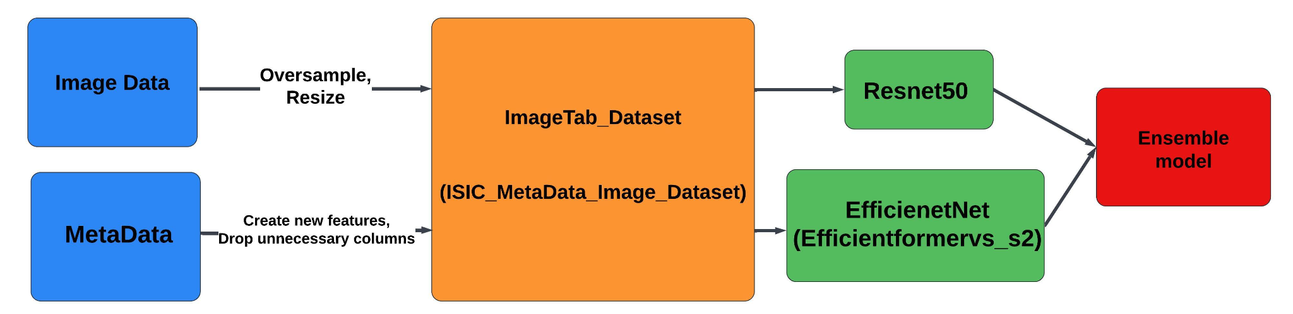
Ensemble Model
Fastai
PyTorch
efficientformerv2_s2
(ImageTab_Dataset)
Notes:
Script:
We decided to tackle this problem in parallel using both FastAI and PyTorch. Despite differences in coding, the structure of the models is quite similar.
As mentioned earlier, we have two types of data to work with: the image data and the CSV metadata. For the image data, we applied oversampling techniques such as rotation, hue adjustment, and contrast augmentation, and resized the images to ensure consistent dimensions. For the metadata, we used synthetic oversampling and created new features from existing ones. In the FastAI approach, we included the number of images per patient as a feature, while in the PyTorch approach, we incorporated interaction terms and feature ratios. We then retained only the non-highly-collinear features.
Using this adjusted data, we defined the FastAI ImageTab_Dataset and the PyTorch ISIC_MetaData_Image_Dataset.
For our models, we utilized several pretrained models, including ResNet50 and EfficientNetV2 for images, and a pretrained EfficientNet from a competitor, which we fine-tuned. We combined the results from these models into an ensemble model to leverage their collective strengths.

Slide 6
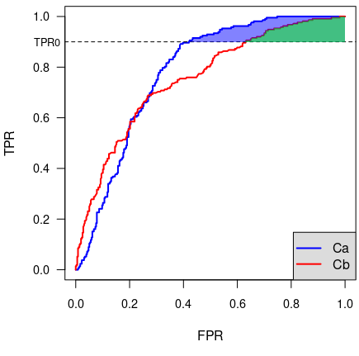
Evaluation
Evaluated on partial area under ROC curve (pAUC) above 80% TPR.
Other surrogate loss functions: Focal Loss, MSE Loss, Binary Cross Entropy Loss
Results on 28% of hidden test set, which contains approximately 500k images
Notes:
Script:
To evaluate the performance of our models, we primarily relied on the scores provided by Kaggle.
Our submissions were evaluated based on the partial area under the ROC curve (pAUC) above an 80% True Positive Rate (TPR) for binary classification of malignant examples. This metric is used because certain regions of the ROC curve are clinically unacceptable. Our scores are based on 28% of a hidden test set, which contains approximately 500,000 images.
Additionally, we employed other surrogate loss functions for easier and faster training, including focal loss, mean squared error (MSE) loss, and binary cross-entropy loss.
With this loss function definition, the best public score so far is 0.189. Our top submissions achieved scores of 0.140 and 0.134.

Slide 7
Results
Oversampling | Image model | Epochs | Loss function | Valid score* | pAUC
100k:10K | Resnet50 +Efficient_v2 | 0+5 0+5 | CrossEntropy | 0.0025 | 0.140
No | Resnet | 0+1 | CrossEntropy | 0.0064 | 0.133
10k:1k | Resnet50 | 5+2 | CrossEntropy | 0.108 | 0.127
100k:10k | Resnet50 | 7+3 | pAUC | 0.962 | 0.018
100k:10k | Resnet50 +Efficient_v2 | 5+2 5+2 | CrossEntropy | 0.088 | 0.090
No | Pytorch ResNet50 | 22 | FocalLoss | 0.0043 | 0.126
No | Pytorch ResNet50 + EfficientNet (Ensemble) | 22+11 | FocalLoss | - | 0.126
Notes:
Script:
This table summarizes some of our attempts; in total, we made 51 submissions on Kaggle, though not all are listed here. The numbers in the epoch column correspond to the learn fit cycle and the fine-tuning cycle. Our first significant model, which was trained on both tabular and image data, is shown on the second line.
Surprisingly, this model performed well after just one fine-tuning cycle, achieving a strong score of 0.133. It took nearly 15 more submissions before we could surpass this result.
We experimented with various strategies, including adding class weights for the target class, implementing the pAUC score as a loss function, and trying different loss functions. We also explored ensemble methods, increased the number of training epochs, and adjusted the oversampling ratio. However, these approaches resulted in public scores that were lower than 0.133.
It wasn’t until our most recent models that we finally saw a meaningful improvement in our scores. The best-performing model was trained on an oversampled dataset with 100k benign images and 10k melanoma images. This model combined an ImageTabular dataset with two pretrained models—ResNet50 and EfficientNetV2—into an ensemble. Each model was fine-tuned for 5 cycles using CrossEntropy as the loss function, with L2 regularization to minimize overfitting, and Adam as the optimizer.

Slide 8
Conclusion
The FastAI ImageTab model delivered the best performance.
Challenges: High RAM usage for DataLoader (slow training and requires lots of memory), Possible overfitting
Advantages of our work: We explored multiple approaches and leveraged various pretrained models, which saved time and yielded good results.
Future work:
We plan to explore other ensemble models and techniques to improve image quality, such as hair removal.
Why does more training lead to a lower score, despite overfitting penalties?
Find more efficient ways to overcome the RAM requirements in the pytorch code.
Notes:
Script:
In summary, the FastAI ImageTab model, using ResNet50 and EfficientNetV2, delivered the best performance.
However, we encountered several challenges during the project. For example, our training was slow and memory-intensive due to high RAM usage while loading image data, which affected both the size of the training set and batch sizes. Additionally, we observed an unexpected trend where the model’s performance decreased with additional training, despite our efforts to prevent overfitting. This behavior is puzzling and requires further investigation to understand its cause.
Furthermore, adjusting the model is challenging because the test set contains only three images, limiting our visibility into its performance until the competition concludes.
Despite these challenges, we explored various approaches and leveraged multiple pretrained models, which helped save time and achieved promising results.
For future work, we plan to investigate other ensemble models and techniques to improve image quality, such as hair removal. We will also continue to address the overfitting issue and seek more efficient methods to handle memory requirements in our code.

